Slide 1

AI Crafters
Team Members
Problem Statement
Solution
Gangwal, Swapnil, 1, CS Pune
Gaindar, Renubala, 1, CS Pune
Sharma, Shradha, CS Pune
Modhawala, Mahima, CS Pune
Kadam, Ranu, CS Pune
Shripati, Madhuri, UBS Mumbai
No automated solution for technical or functional query of business users/L2 team
With information spread across various sources like Sharepoint, Confluence, PDFs, Docs, PPTs - search through all platforms is time consuming
Operation team’s dependency on incident prioritization and assignment for basic queries
“AI Crafter” is a conversational AI to cater functional and technical queries about Credit Desktop application
Provides a User Interface for uploading datasets for pre-training purpose
Works on the principle of retrieving accurate data from massive volume of data sources
Wouldn’t be limited to a single application, but can be scaled as per datasets of other portfolios as well
Would result in real time query resolution
~25-30% FTE reduction thereby saving costs

Slide 2
AI Crafters – Architecture
User Interface
(AI Crafter)
User Request
Request analysed using NLP, FAISS
Dialogue Management
Manage complex and multi intent conversation
Provide Real time response
Information Retrieval
Data Sources
Database
Confluence
SharePoint
Excel
PDF/DOC
Chatbot Response
Response generation using Deep Learning - LLM

Slide 3




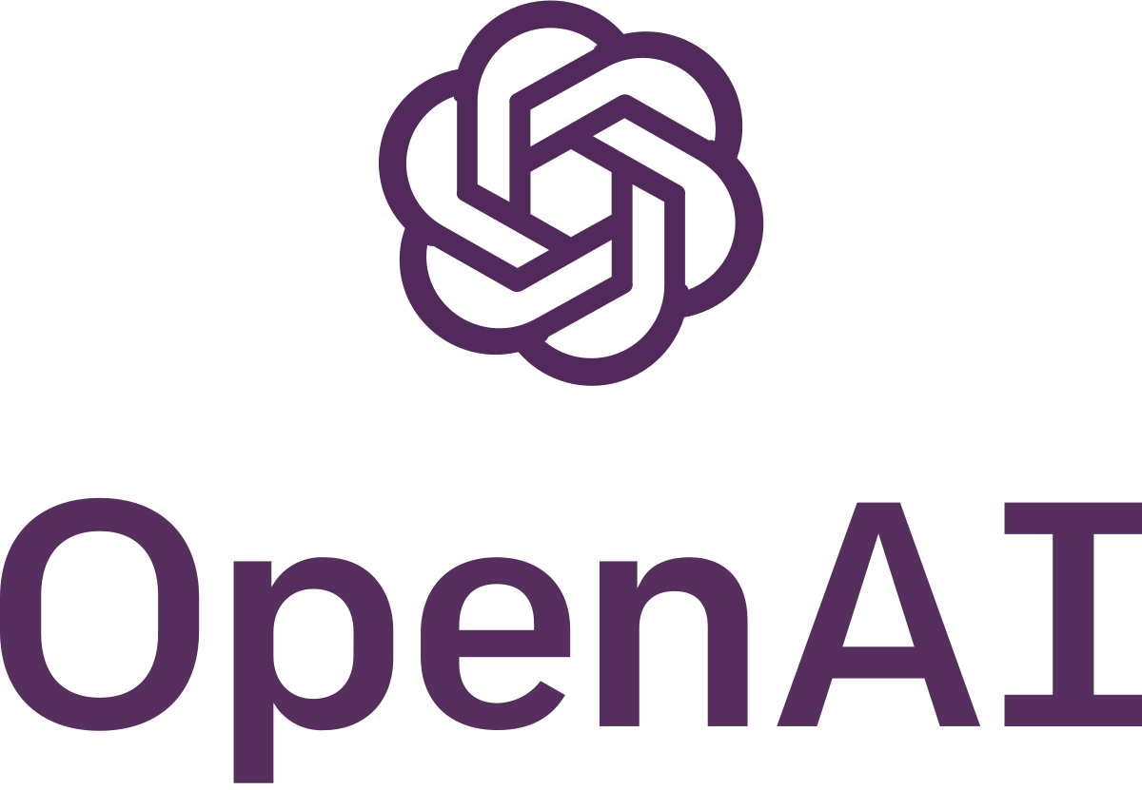

AI Crafters – Tech Stack
Python
OpenAI
ChatGPT 4
AI/ML Algorithms
LLM
FAISS – NLP
Streamlit
SQL

Slide 4
AI Crafters – Benefits
24*7 Availability
Superfast Response
Accurate access to information
Text to SQL conversion
Offer to raise JIRA ticket based on user preference

Slide 5

AI Crafters – What Next?
Easy scalability to other portfolio/streams using respective datasets
Reference to old incidents with similar queries
Connection to confluence for enhanced repository
Display server statistics and CPU usage from servers – OpenShift/JAP/Grafana

Slide 6
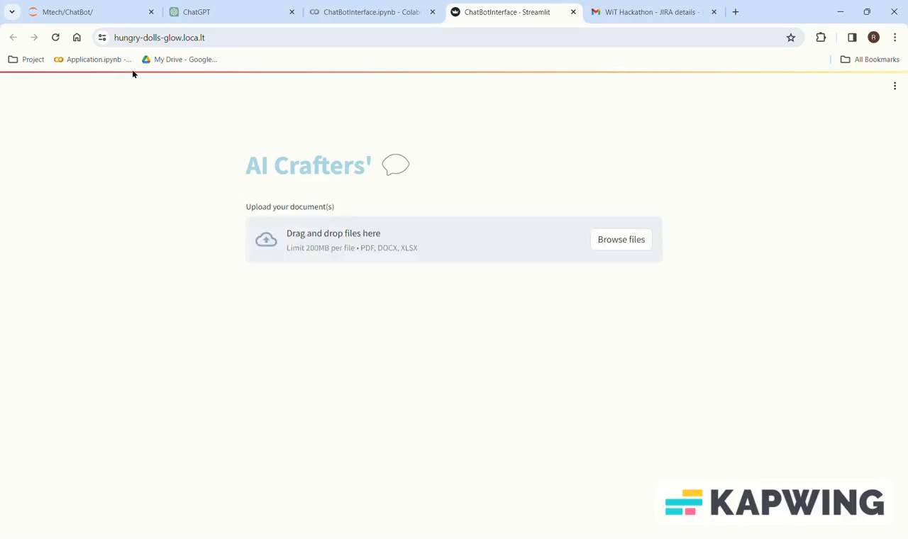
AI Crafters
Live Demo..

Slide 7
AI Crafters
Q&A?

